Slide 1
WATER TRANSPORT AND FERRYING SYSTEM
By
145696,145944
Supervisor: Emmanuel Olang

Slide 2
PROBLEM STATEMENT
Recently, there has been a rapid increase in the frequency of accidents in addition to organizations realizing losses brought about by the regular use of water transport.
Factors contributing to this include the overcrowding of passengers on ships, the bundling of freight to undesirable locations, the loss of freight or, occasionally, the loss of freight in transit. The cargo is unlikely to be inspected for the duration that it is in these unfavorable conditions as the ship has been lying on water for a substantial period of time.
In such circumstances, unaccounted goods can result in organizations incurring losses and passengers sustaining injuries or passing away, leaving carriers at danger of legal action and, in most cases, if not all, requiring them to pay some sort of compensation to the harmed parties. The drawback in this is that most businesses will lose credibility and legitimacy if they mishandle or lose cargo or overburden travelers.

Slide 3
No. | Module | No. | Submodule
1 | Passenger | 1.1 1.2 1.3 1.4 1.5 1.6 1.7 | Register Account Login/Logout Book Ferry Update booking View Booking Make payment Get ticket
2 | Organization | 2.1 2.2 2.3 2.4 2.5 2.6 2.7 | Register Account Login/Logout Book Ferry Update Booking View Booking Make payment Get ticket
3 | Port Operator | 3.1 3.2 3.3 3.4 3.5 | Register Account Login/Logout View Bookings Display Available Ferries View tickets
4 | Administrators | 4.1 4.2 4.3 4.4 4.5 4.6 4.7 | Register Account Login/Logout View Bookings View Payments View Login activity Update Bookings Display available Ferry
5 | System | 5.1 5.2 5.3 5.4 | Record User Activity Update Ticket Status View Tickets Send electronic tickets

Slide 4
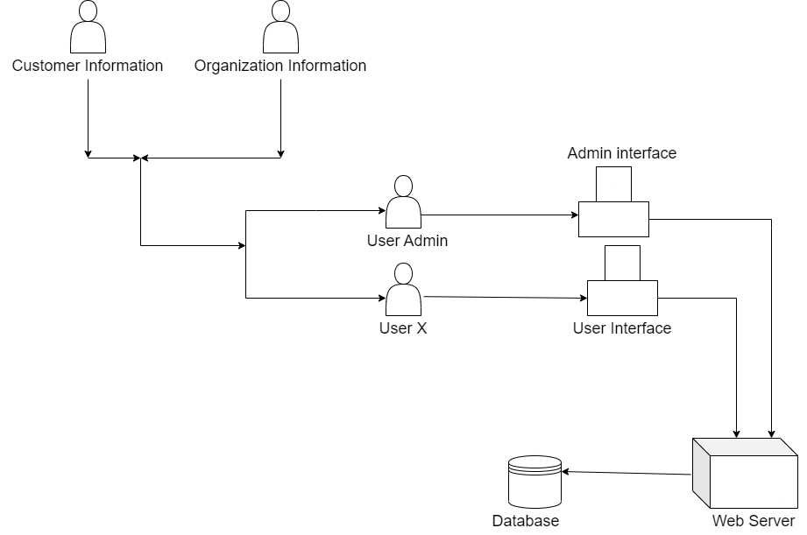

Slide 5
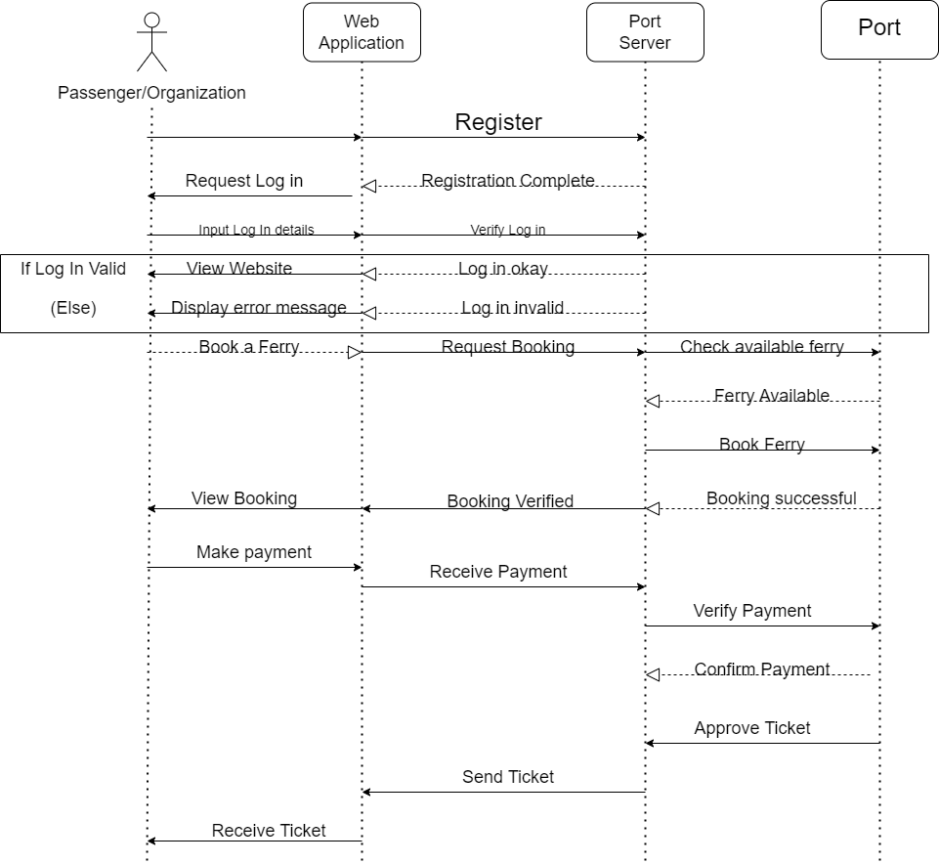

Slide 6
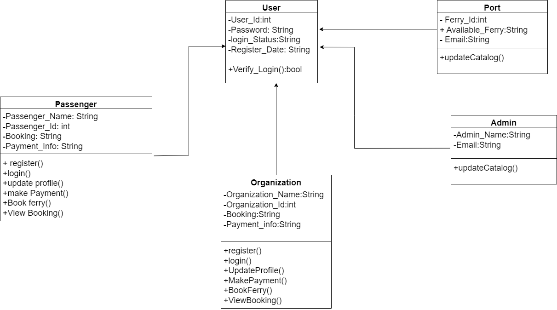

Slide 7
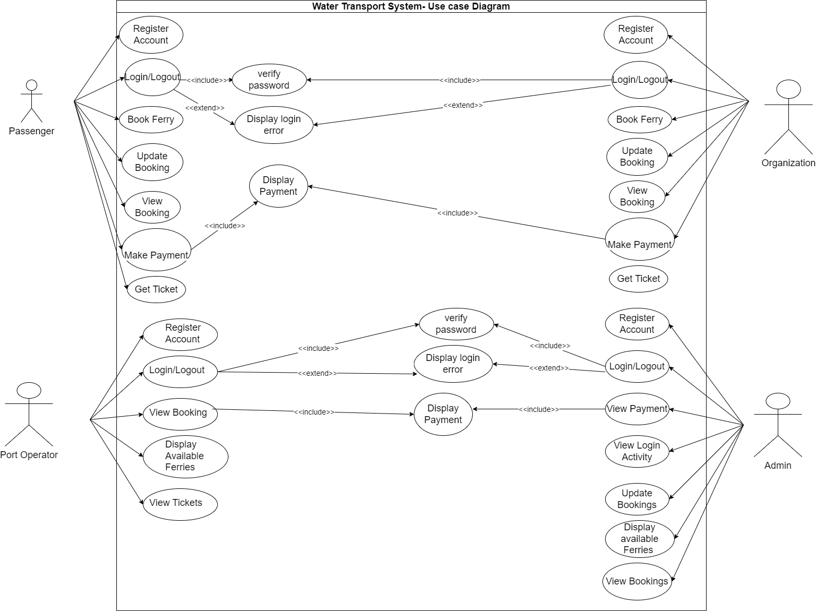

Slide 8
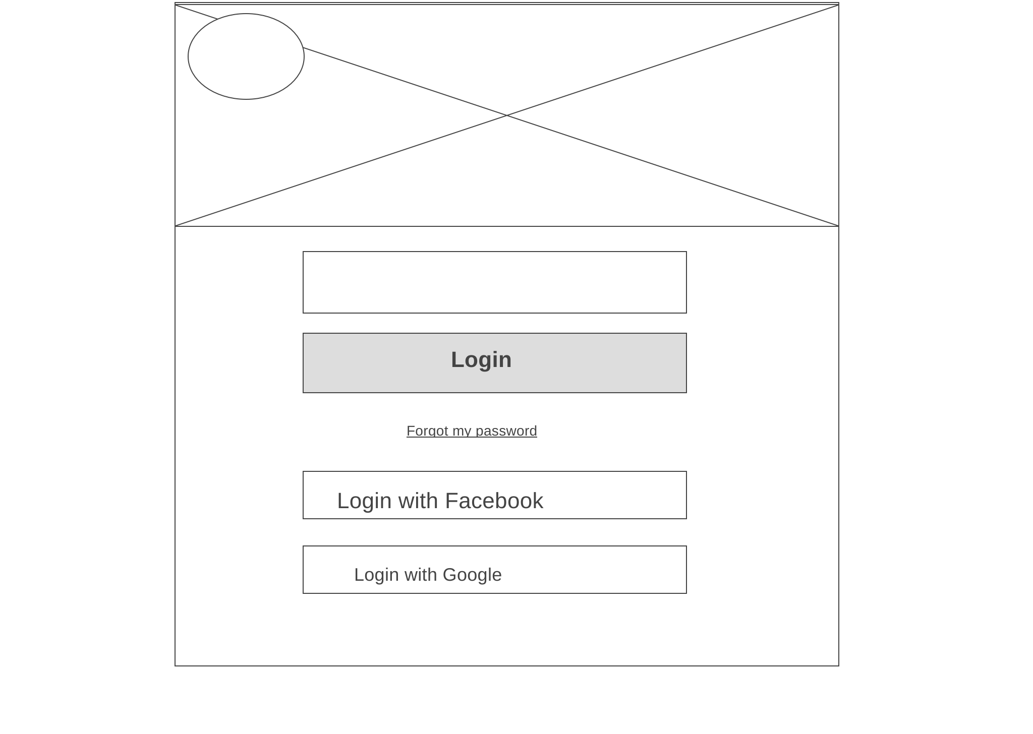
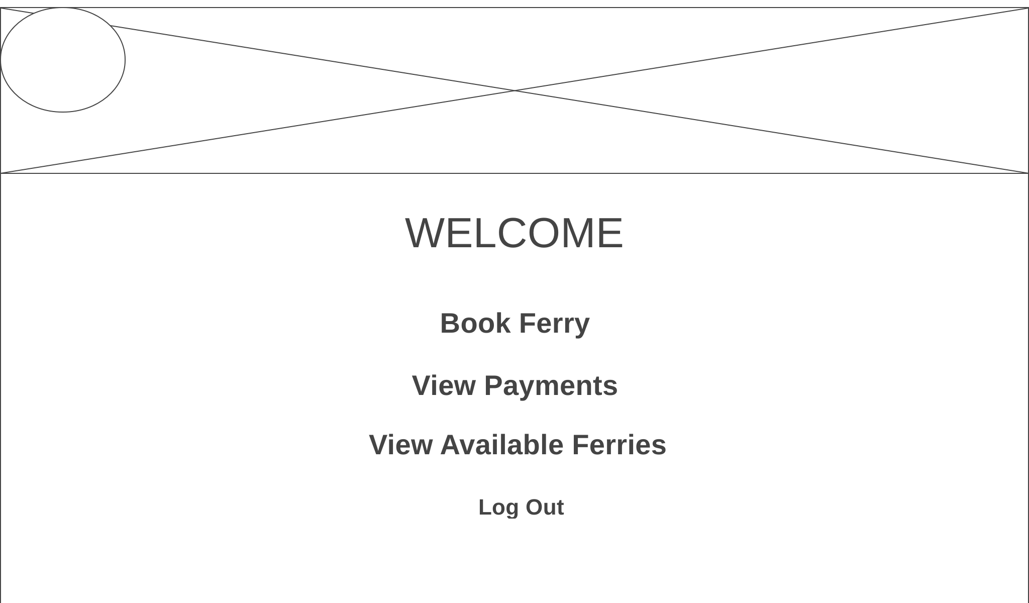
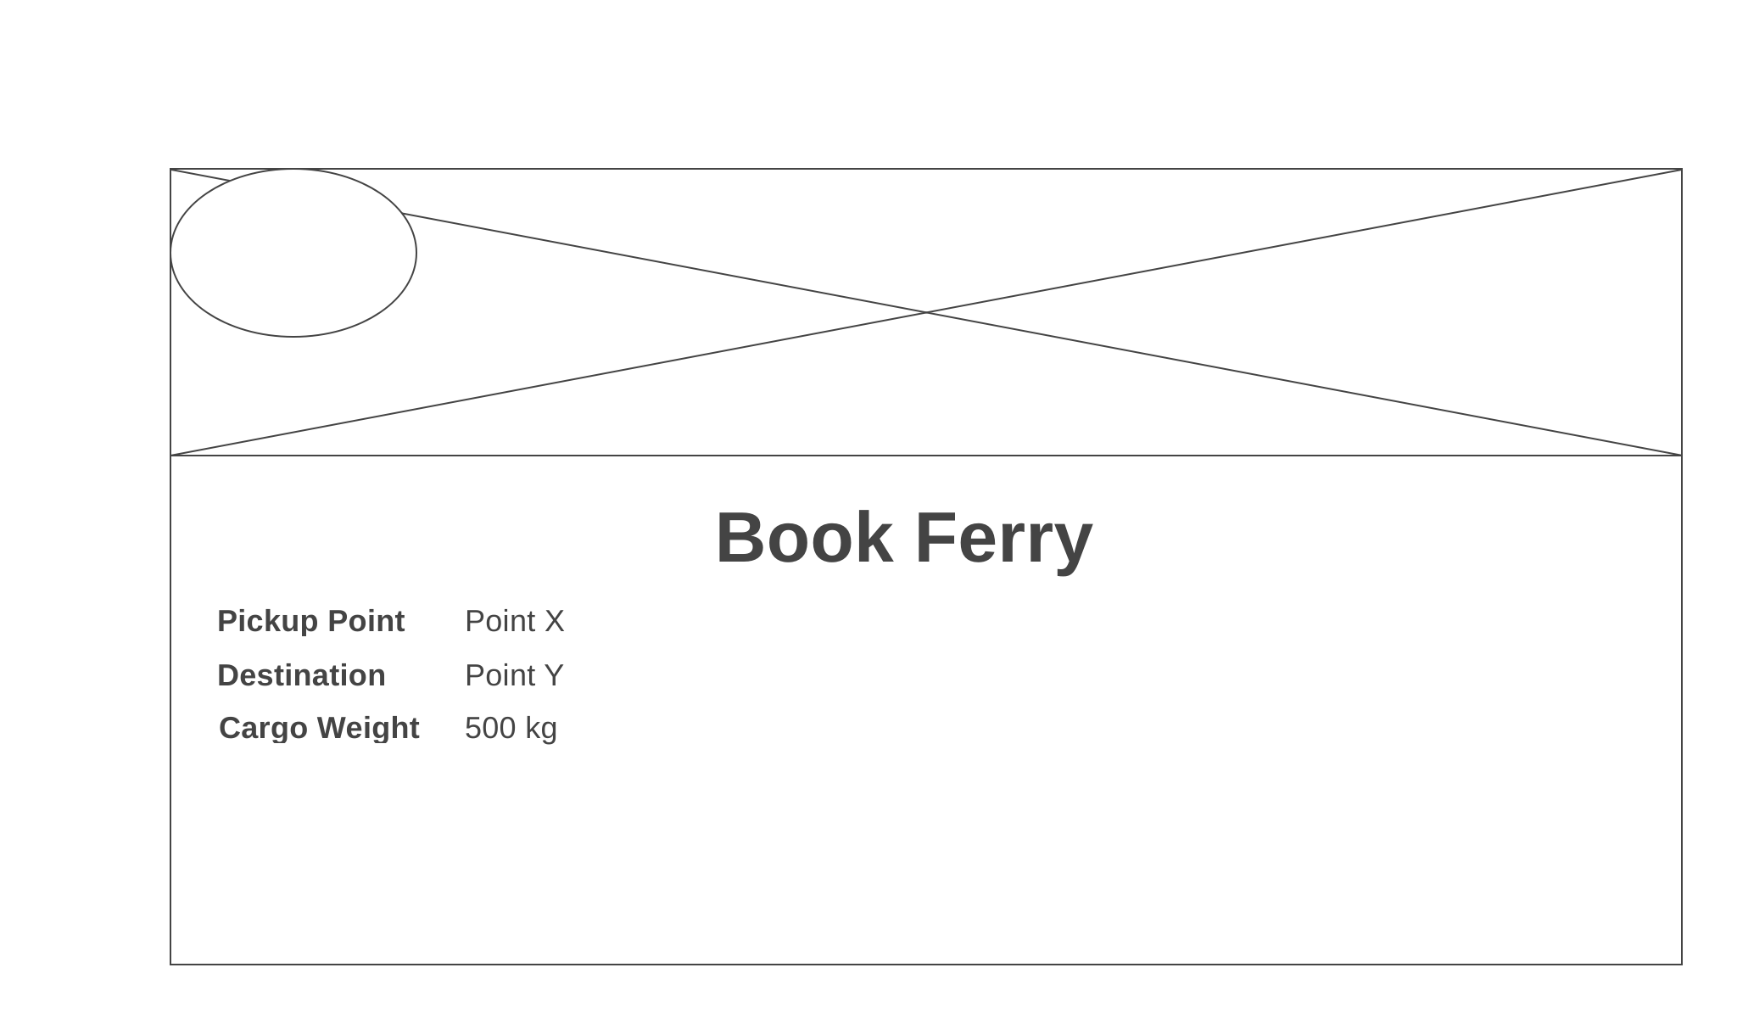

Slide 9
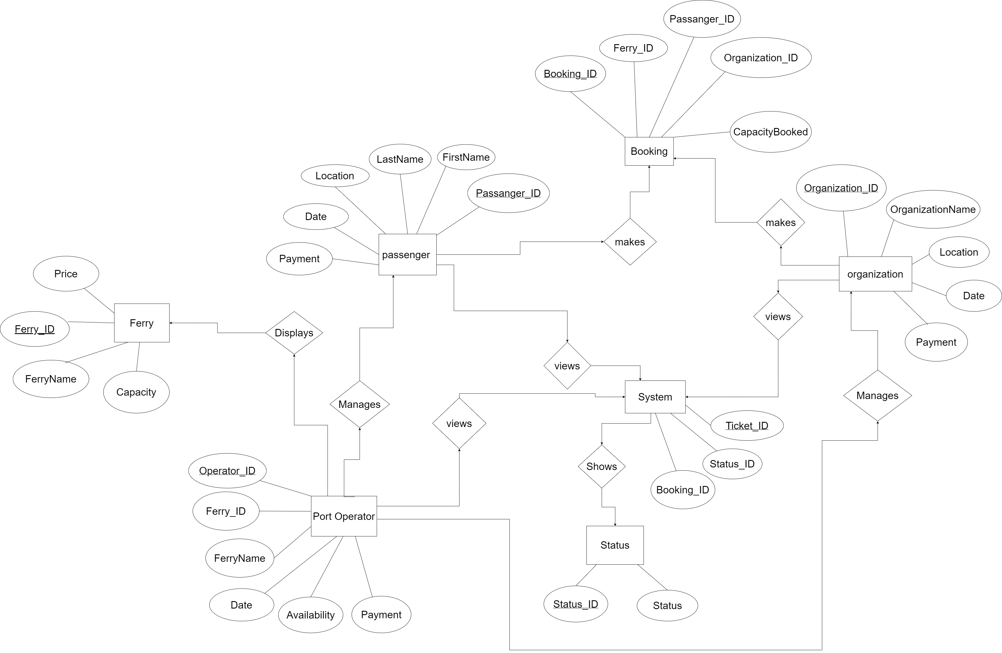

Slide 10
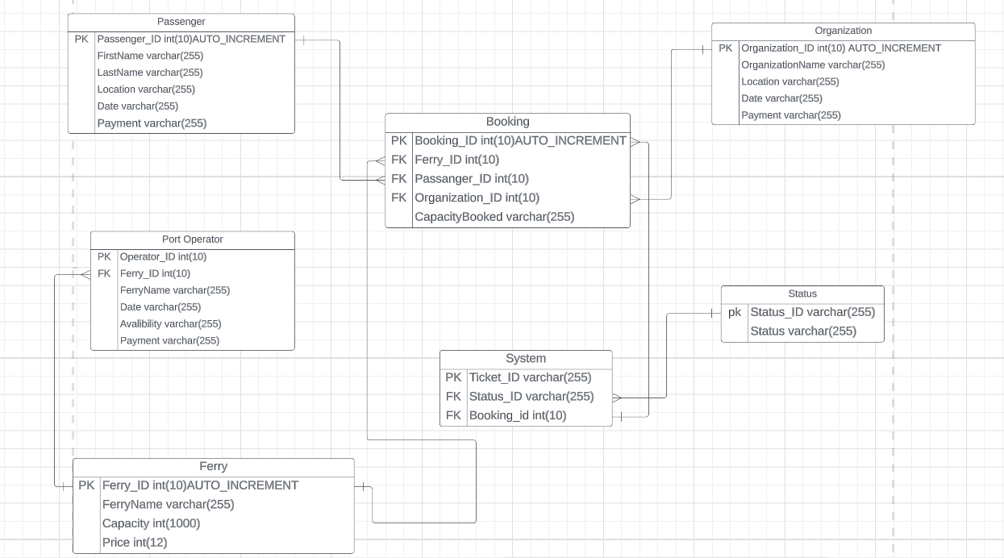

Slide 11
ANY QUESTIONS OR FURTHER CLARIFICATIONS ARE WELCOMED
THANK YOU AND HAVE A LOVELY WEEKEND

